Slide 1
DESIGNING OF SYSTEMS SCIENCE LAB USING SLP
Introduction to Manufacturing Systems
By-
Krati Saxena
Neha Singh Chauhan

Slide 2
Introduction
SLP (Systematic Layout Procedure) involves
developing a relationship chart showing the degree of importance of having each department located adjacent to every other department.
From this chart, an activity relationship diagram, similar to the flow graph used for illustrating material handling between departments, is developed.
The activity relationship diagram is then adjusted by trial and error until a satisfactory adjacency pattern is obtained. This pattern, in turn, is modified department by department to meet building space limitations.

Slide 3
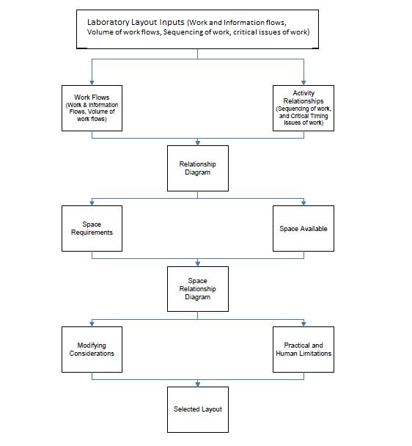
Block Diagram of SLP

Slide 4
What we are planning to do?
Designing of Laboratories for Systems Science Department using SLP algorithm.
As per the course structure, we've concluded that we will be requiring total of 7 labs which are categorized as follows:
  Embedded Systems lab
  Robotics and control systems
  Systems Designing lab
  Finance lab
  Complex Networks lab
  R&D center
  Computer center

Slide 5
Space Requirements and Relationships
Space Requirements-
Total area that we've considered is 7000 sq.ft.
Walking area and area required for movement of equipments is decided to be kept 25% of the total area.
Relationships-
As defined in the SLP algorithm, we've used the "A E I O U X" convention to weight the relationships between the labs.
Similar kinds of lab with similar applications are related.

Slide 6
Conclusion
After making the relationship diagrams, we will allocate space for each lab, and prepare the space relationship diagram.
Possible Alternative layouts will be prepared.

Slide 7
THANK YOU

